Slide 1

Vivekanand Education Society’s Institute Of Technology
Department Of Computer Engineering
Twitter as a Distributed system
Group Members: Mentor Name:
Anish Adnani (01) Dr. Mrs. Anjali Yeole
Nihal Bhandary (10) Mrs. Sunita Sahu
Supriya Patil (50)

Slide 2
Index:
SR. NO. | Topic | Page No.
1. | Introduction | 3
2. | Communication | 6
3. | Transparency | 11
4. | Synchronization | 12
5. | Consistency and Replication | 13
6. | Fault Tolerance | 15
7. | Security | 16
8. | Conclusion | 18
9. | Reference | 19

Slide 3
INTRODUCTION
Twitter is one of the most complicated system with some whooping stats mentioned further; 400 Million Tweets a day, 5000 Tweets per second, 336 Million active users, 100 Million daily active users, and so on
23% of the internet population is said to be on Twitter
2 Billion queries are served by Twitter on daily basis
Twitter is politically persuasive, the very reason being, 83% of the world’s leaders have a Twitter account
Estimated revenue earned by Twitter is $545 Million

Slide 4
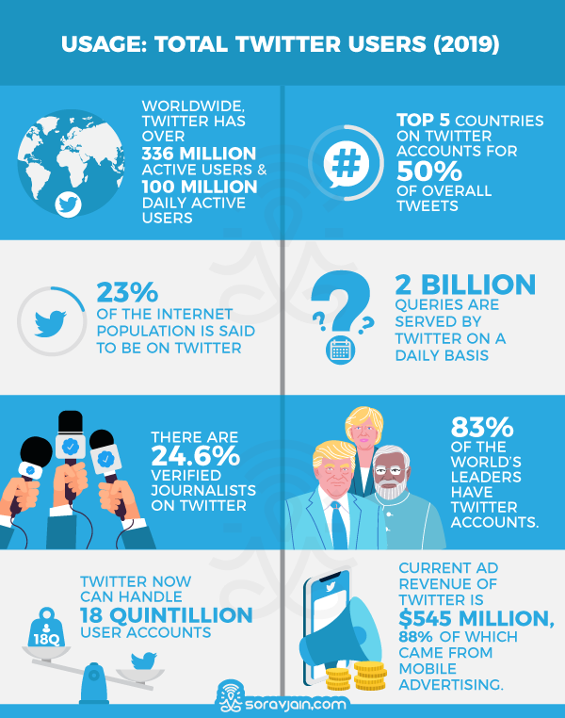
INTRODUCTION

Slide 5
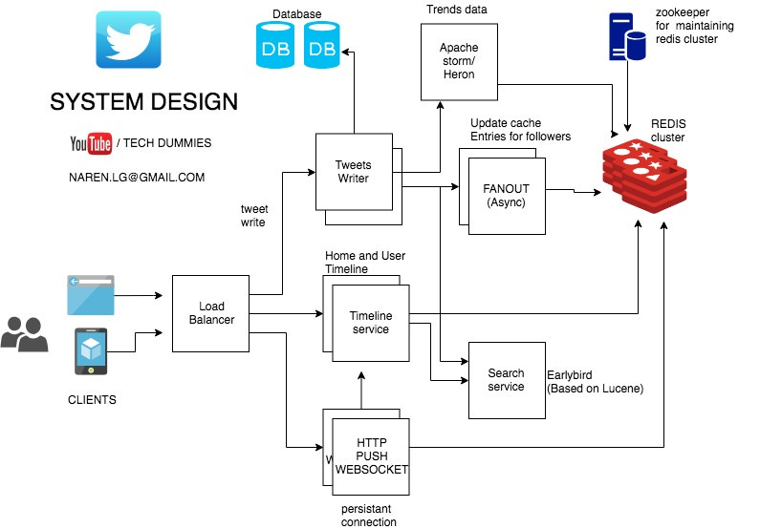
System Design

Slide 6
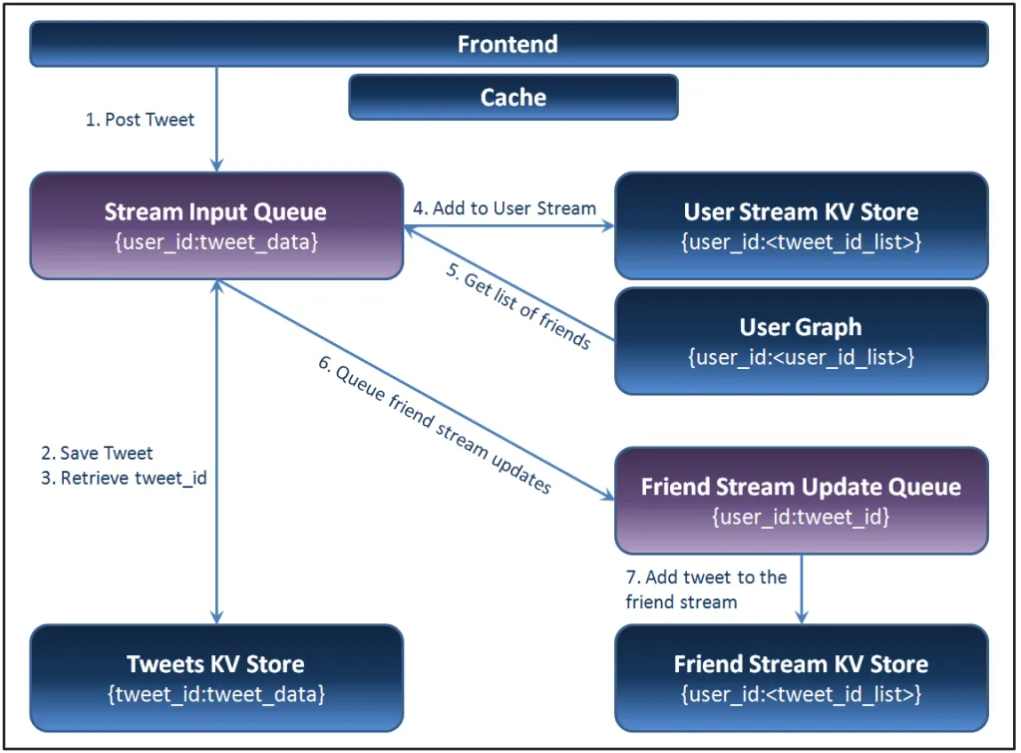
COMMUNICATION

Slide 7

COMMUNICATION
The microservice architecture comprises many different services with varying capacity requirements.
There are Caches available for each user, which updates their followers tweets, retweets, etc for faster access rather than searching the whole database
Twitter uses Redis , Redis basically gives mapping between unique identifier (user_id) and other notables like their tweets, it contains its own data structure to map list of Tweets to the user_id
In order to properly utilize all the replicas of a service cluster, a client-side load balancer can be enabled in every client. This allows it to operate with fewer layers of physical infrastructure

Slide 8
COMMUNICATION
Redis Data Structure has following operations
LPUSH - Insert all the specified values at the head of the list stored in the key
Eg : LPUSH mylist “Hello”
LRANGE - Returns the specified elements of the list stored at key
Eg : LRANGE mylist 0 0
LTRIM, etc are few other commands that are used

Slide 9
COMMUNICATION
PowerTrack, Volume (e.g. Decahose, Firehose), and Replay streams utilize Streaming HTTP protocol to deliver data through an open, streaming API connection. Rather than delivering data in batches through repeated requests by your client app, as might be expected from a REST API, a single connection is opened between your app and the API, with new results being sent through that connection whenever new matches occur. This results in a low-latency delivery mechanism that can support very high throughput.

Slide 10
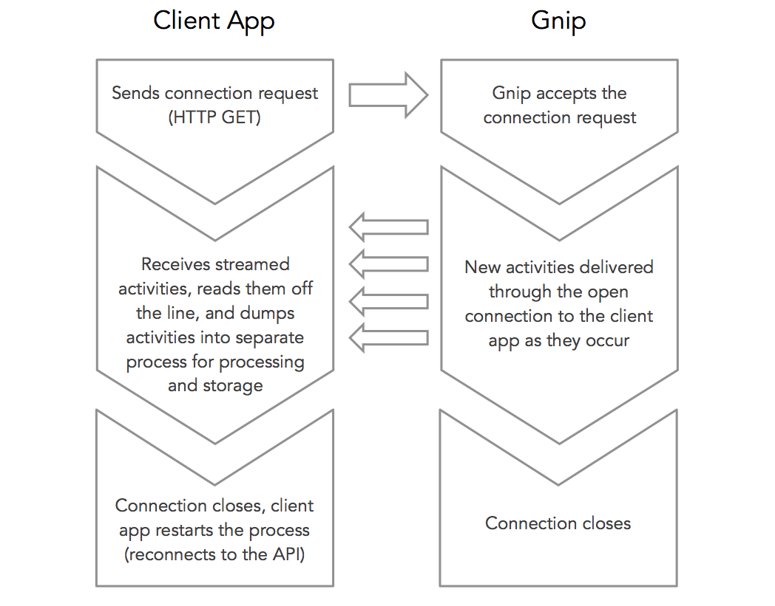
COMMUNICATION

Slide 11
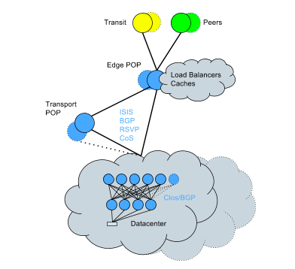
TRANSPARENCY
They had deep buffer ToRs to support bursty service traffic and carrier grade core switches with no oversubscription at that layer
These packet buffers allow to redirect user traffic to different servers located all over the globe.
The user queries are serviced without them knowing which server has performed the query. This is Fragmentation transparency in action.

Slide 12
SYNCHRONIZATION
When a user tweets a photo, They send the photo off to one of a set of Blobstore front-end servers. The front-end understands where a given photo needs to be written, and forwards it on to the servers responsible for actually storing the data. These storage servers, write the photo to a disk and then inform a Metadata store that the image has been written and instruct it to record the information required to retrieve the photo.
This Metadata store, which is a non-relational key-value store cluster with automatic multi-DC synchronization capabilities, spans across all of Twitter’s data centers providing a consistent view of the data that is in Blob store
Apart from that twitter uses Redis which has the option to synchronize cluster node's clocks using Chrony and/or NTP.

Slide 13
CONSISTENCY AND REPLICATION
Apache Kafka is used for the “replay system” in Twitter architecture.
On this Kafka topics, they created multiple partitions using the default semantic partitioning mechanism. Therefore, partitions correspond to the hash of a developer’s webhookId, which is the key for each record.
These topics are then cross-replicated to ensure redundancy which allows for serving a replay request out of one DC. These stored events are deduplicated before they are delivered.

Slide 14
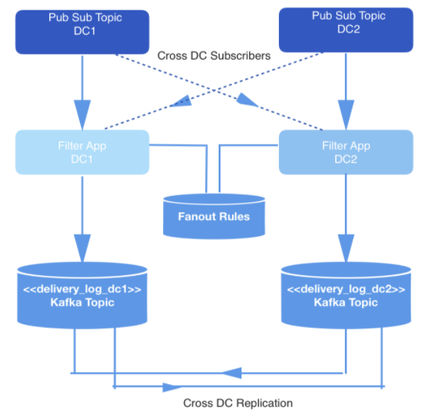
CONSISTENCY AND REPLICATION
Real-time events are produced in two datacenters (DCs). When these events are produced, they are written into pub-sub topics that are cross-replicated across the two DCs for redundancy purpose

Slide 15
FAULT TOLERANCE
Cross-Data Center Writes: the Live Spend Counter always writes to both the Spend Cache in the “alternate” data center as well as its own. It also writes some metadata about the health of that data. Each Live Spend Counter instance maintains two separate datasets, one computed with only local information, and one computed with the writes from the remote instance.
Dataset Health Check: When serving an ad request, the Adserver pipeline reads both versions of the data, and automatically selects which one to use based on which dataset is healthier.
If the local Spend Cache falls behind, the Ad Server is able to detect this and switch automatically to using the data set containing the writes from the remote data center. When the issue is resolved locally, the Ad Server will automatically switch back to using the local dataset since it is as healthy as the other one.

Slide 16
SECURITY
On top of the usual confidentiality and integrity properties of HTTPS, forward secrecy adds a new property. If an adversary is currently recording all Twitter users’ encrypted traffic, and they later crack or steal Twitter’s private keys, they will not be able to use those keys to decrypt the recorded traffic.
One aspect of the platform that has been top of mind since the beginning is the importance of serving the health of the public conversation and protecting the personal data of people using Twitter. The new platform takes a strong stance on where related business logic should live by pushing all security and privacy related logic to backend services. The result is that the API layer is agnostic to this logic and privacy decisions are applied uniformly across all of the Twitter clients and the API

Slide 17
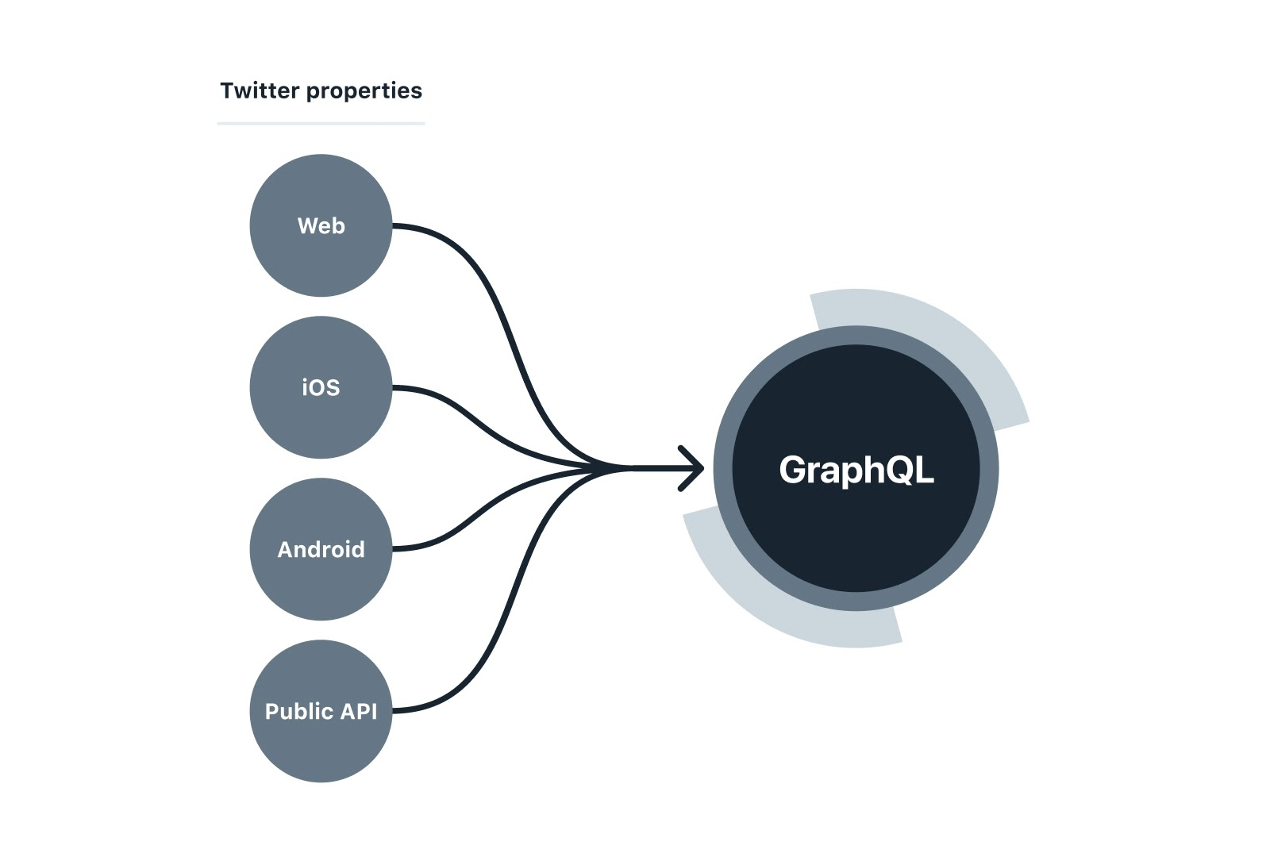
SECURITY
Representatives from teams building Twitter for web, iOS, and Android began migrating from individual internal REST endpoints to a unified GraphQL service
When an endpoint’s business logic can be represented in StratoQL (the language used by Twitter’s data catalog system known as Strato which powers the GraphQL schema), then we only need to write a function in StratoQL without requiring a separate service.
With the platform providing the common needs for all HTTP endpoints, new routes and resources can be released without spinning up any new HTTP services

Slide 18
CONCLUSION
Twitter is one of the most Ready heavy systems with about 600,000 Tweets reads per second. To overcome this and serve it users it uses Redis which allows much faster access, but relying completely on redis may cause problems hence copy of data is also stored in the database.
Load balancers are used to reduce the load on a particular node and twitter protects the data by using forward secrecy which is above the integrity properties of HTTPS.
Hence making Twitter fast, safe and secure distributed system .

Slide 19
REFERENCES
[1] https://0x0fff.com/twitter-architecture-analysis-part-1/
[2]https://blog.twitter.com/engineering/en_us/topics/infrastructure/2017/the-infrastructure-behind-twitter-scale.html
[3] https://blog.twitter.com/engineering/en_us/a/2016/strong-consistency-in-manhattan.html
[4] https://blog.twitter.com/engineering/en_us/a/2013/forward-secrecy-at-twitter.html
[5] https://www.youtube.com/watch?v=wYk0xPP_P_8
[6] https://redis.io/commands

Slide 20
THANK YOU

